Slide 1
TTBizlink Project
Ministry of Trade, industry, investment & communications

Slide 2
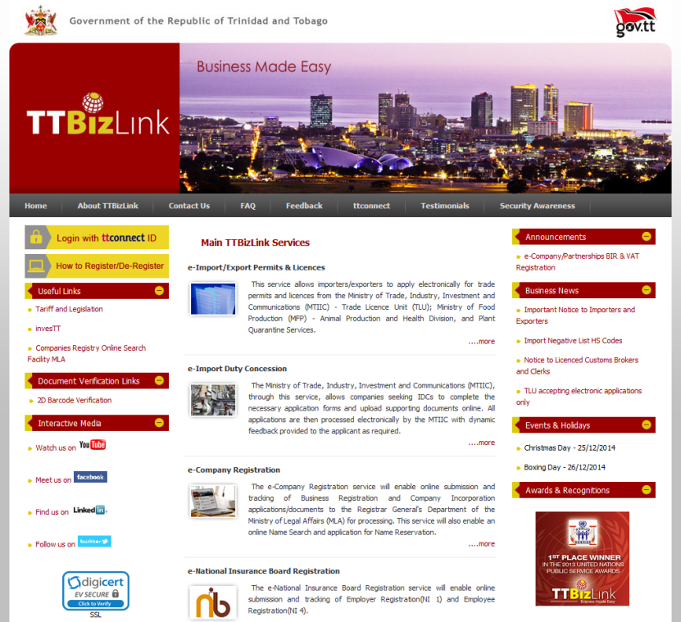
About the best practice/reform initiative
Secure, online platform for the submission and processing of trade and business related government applications.
Platform launched in 2012
Accessible at www.ttbizlink.gov.tt

Slide 3
Overview
The implementation of TTBizlink assists our Ministry in achieving its mandate to facilitate and develop trade by:
Reducing paperwork, bureaucracy and time lost associated with doing business across multiple government ministries and departments;
Increase transparency and faster turnaround times for processing of applications;
Improvement in Trinidad and Tobago’s ease of doing business ranking .

Slide 4
Best practice/reform in operation
International Best Practices – TradeNet ®, Recommendations and Guidelines on establishing a Single Window developed by the United Nations Centre for Trade Facilitation and Electronic Business (UN/CEFACT-Recommendation No.33)
Legislative reform – Electronic Transactions Act and Data Protection Act of 2012
Automation – Online receipt, processing and storage of applications
Integration – Sharing of data among agencies
Business process re-engineering
‘One stop shop’ for the business community

Slide 5
Change management process
Consultations with the world bank – recommendation on the use of an SEW
Research and visits on the operations of Single Electronic Windows across the world and identify best practices
Endorsement of Prime Minister and Minister of Trade, Industry, Investment and Communications. Inter-ministerial committee set up to guide implementation
Stakeholder engagement – all phases of development and implementation (requirements gathering, system specification, system design, user acceptance testing, live simulations, support and troubleshooting)
Overcoming resource constraints – Training of personnel, hiring of new staff, provision of IT infrastructure
Teaching and Troubleshooting for users – Development of training manuals, video tutorials and toll free help desk call centre

Slide 6
Constraints
Resistance to change addressed by stakeholder consultations, inclusion in project teams, experts guidance, providing on-site technical and operational support, formalizing training, ensuring transparency and accountability by Memoranda of Understanding, and establishment of a Help Desk.
Cost and technical resource constraints addressed by the formation of a specialized Project Management Office staffed by carefully selected returning national scholars and collaborating with other Public Sector Agencies.
Absence of relevant national policies addressed by formation of cross-functional teams to draft policies, assisted by international consultants.

Slide 7
Enabling factors
Feasibility study undertaken to review best practices, international standards, the enterprise-wide ICT and public administration reforms, to ensure project’s customization and complementarity with other reforms.
Strategic Leadership and Effective Project Governance established, ensuring the country’s Cabinet approved the Project thus, allowing use of TTBizLink.
Inter-Ministerial Steering Committee with various sub-committees established to guide implementation.
Stakeholder commitment and cooperation sought from inception.
Automation undertaken in conjunction with business process reengineering.
Effective communications plan developed and implemented.
Specialized Project Management Office established within the MTIIC – staffed by competent professionals, with defined roles and responsibilities; founded on Performance Based and Knowledge Management; Help Desk established; formalized arrangements for training.
Transparency, confidentiality and security assured by system’s inherent security features, including a self-audit facility.
Agreements made with agencies to adhere to strict service standards for processing online applications.
All e-Services are monitored with reports prepared monthly on its performance, challenges and recommendations for improvement.

Slide 8
impact
Advanced in the Doing Business Report to 66th in 2014 from 88th in 2008.
Pioneered e-Business legislation relating to Data Protection and Electronic Transactions.
Over 3,400 active users accounting for over 140,000 transactions since February 2012, across 27 e-services.
Enhanced data sharing and increased productivity amongst agencies involved.
Requests by new and existing agencies to have more of their services available on the platform
Recognition by the United Nations Public Service Award – 2013
Many positive feedback and testimonials from our users

Slide 9
sustainability
Training for in-house staff by our system developers
Implementation of knowledge management systems
Knowledge Transfer Agreements with system developers
Maintaining good inter-ministry/agency relationships

Slide 10
Lessons learnt
Innovation in the public service is possible but requires careful planning and stakeholder involvement.
Solid commitment, clearly defined and agreed to goals by key stakeholders, from project inception is fundamental.
Mechanisms must be effected that build transparency and hence trust.
Required policy and legislative frameworks must be in place.
Careful deliberation must be given to lead consulting team selection with due regard to tendering processes.
Implementation must be based on a thorough, constructive and critical investigation of existing processes to determine gaps and resources needs.
Performance must be consistently monitored against recognized benchmarks.
Small developing Caribbean countries have the capacity and capability to implement transformative projects of complex dimensions.

