Slide 1
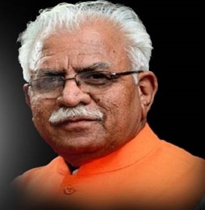
CM WINDOW
Haryana
Manohar Lal Khattar
Chief Minister, Haryana
ONLINE GRIEVANCES REDRESSAL SYSTEM

Slide 2
In previous regime everyday individuals from each corner of the state used to visit chief minister’s residence for redressal of their grievances (Janta Darbaar) and there was no formal mechanism for redressal or follow up of those letters forwarded.
After witnessing this Hon’ble Chief Minister Haryana came up with the idea to made himself available for each and every citizen in their respective districts.
Thereafter, C.M. window was setup in every district of Haryana on 25th December 2014.

Slide 3
These kiosks were setup in every deputy commissioner’s office where people can directly file their grievances and the same gets uploaded on Chief Minister’s grievances redressal portal.
After the receiving the grievance the same is marked by the officers of CM office to the concerned department and department ought to redress the grievances within 3o days.

Slide 4
At every district head quarters 2 computer operators were appointed specially for this project.
Every kiosk was equipped with 2 desktop machines with printing and scanning facility and internet connection
At every district City Magistrates were appointed as nodal officers.
In departments class 1 officers were appointed as nodal officers by their respective Administrative secretaries.

Slide 5
OVERVIEW OF THE MONITORING DESK
All the grievances are being monitored on daily basis and prior to disposal same is being inspected at 3 levels.
A call Centre was setup to monitor the satisfaction index.

Slide 6
OBSTACLES FACED
Segregation of grievances
Judicial and quasi judicial matters.
RTI applications
Transfer Notes
Demand of Jobs
Financial Assistance
Grievance related to multiple departments.
Poor quality of action taken reports.
Inquiry of same official marked to same official.

Slide 7
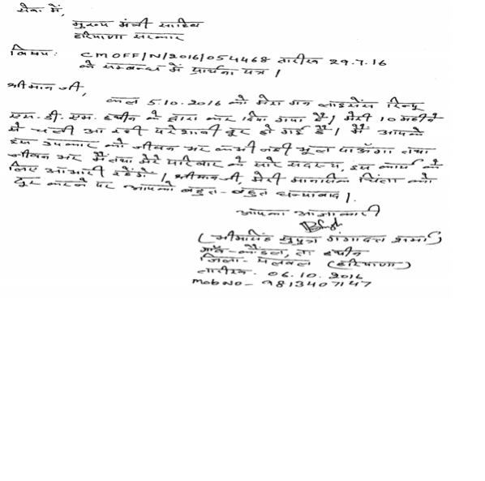
Footfall in janta darbar has reduced from few hundreds to just a handful.
Grievances which were being received by the CMO in the form of letters has reduced.
Constant monitoring of grievances which earlier was not possible.
THANKS LETTER

Slide 8
Extension of Cm window to sub division level.
To link CM grievances to Facebook and Twitter pages of chief minister and government of Haryana pages.
To establish special teams at district level for redressal of grievances.

Slide 9
Thanks

