Slide 1
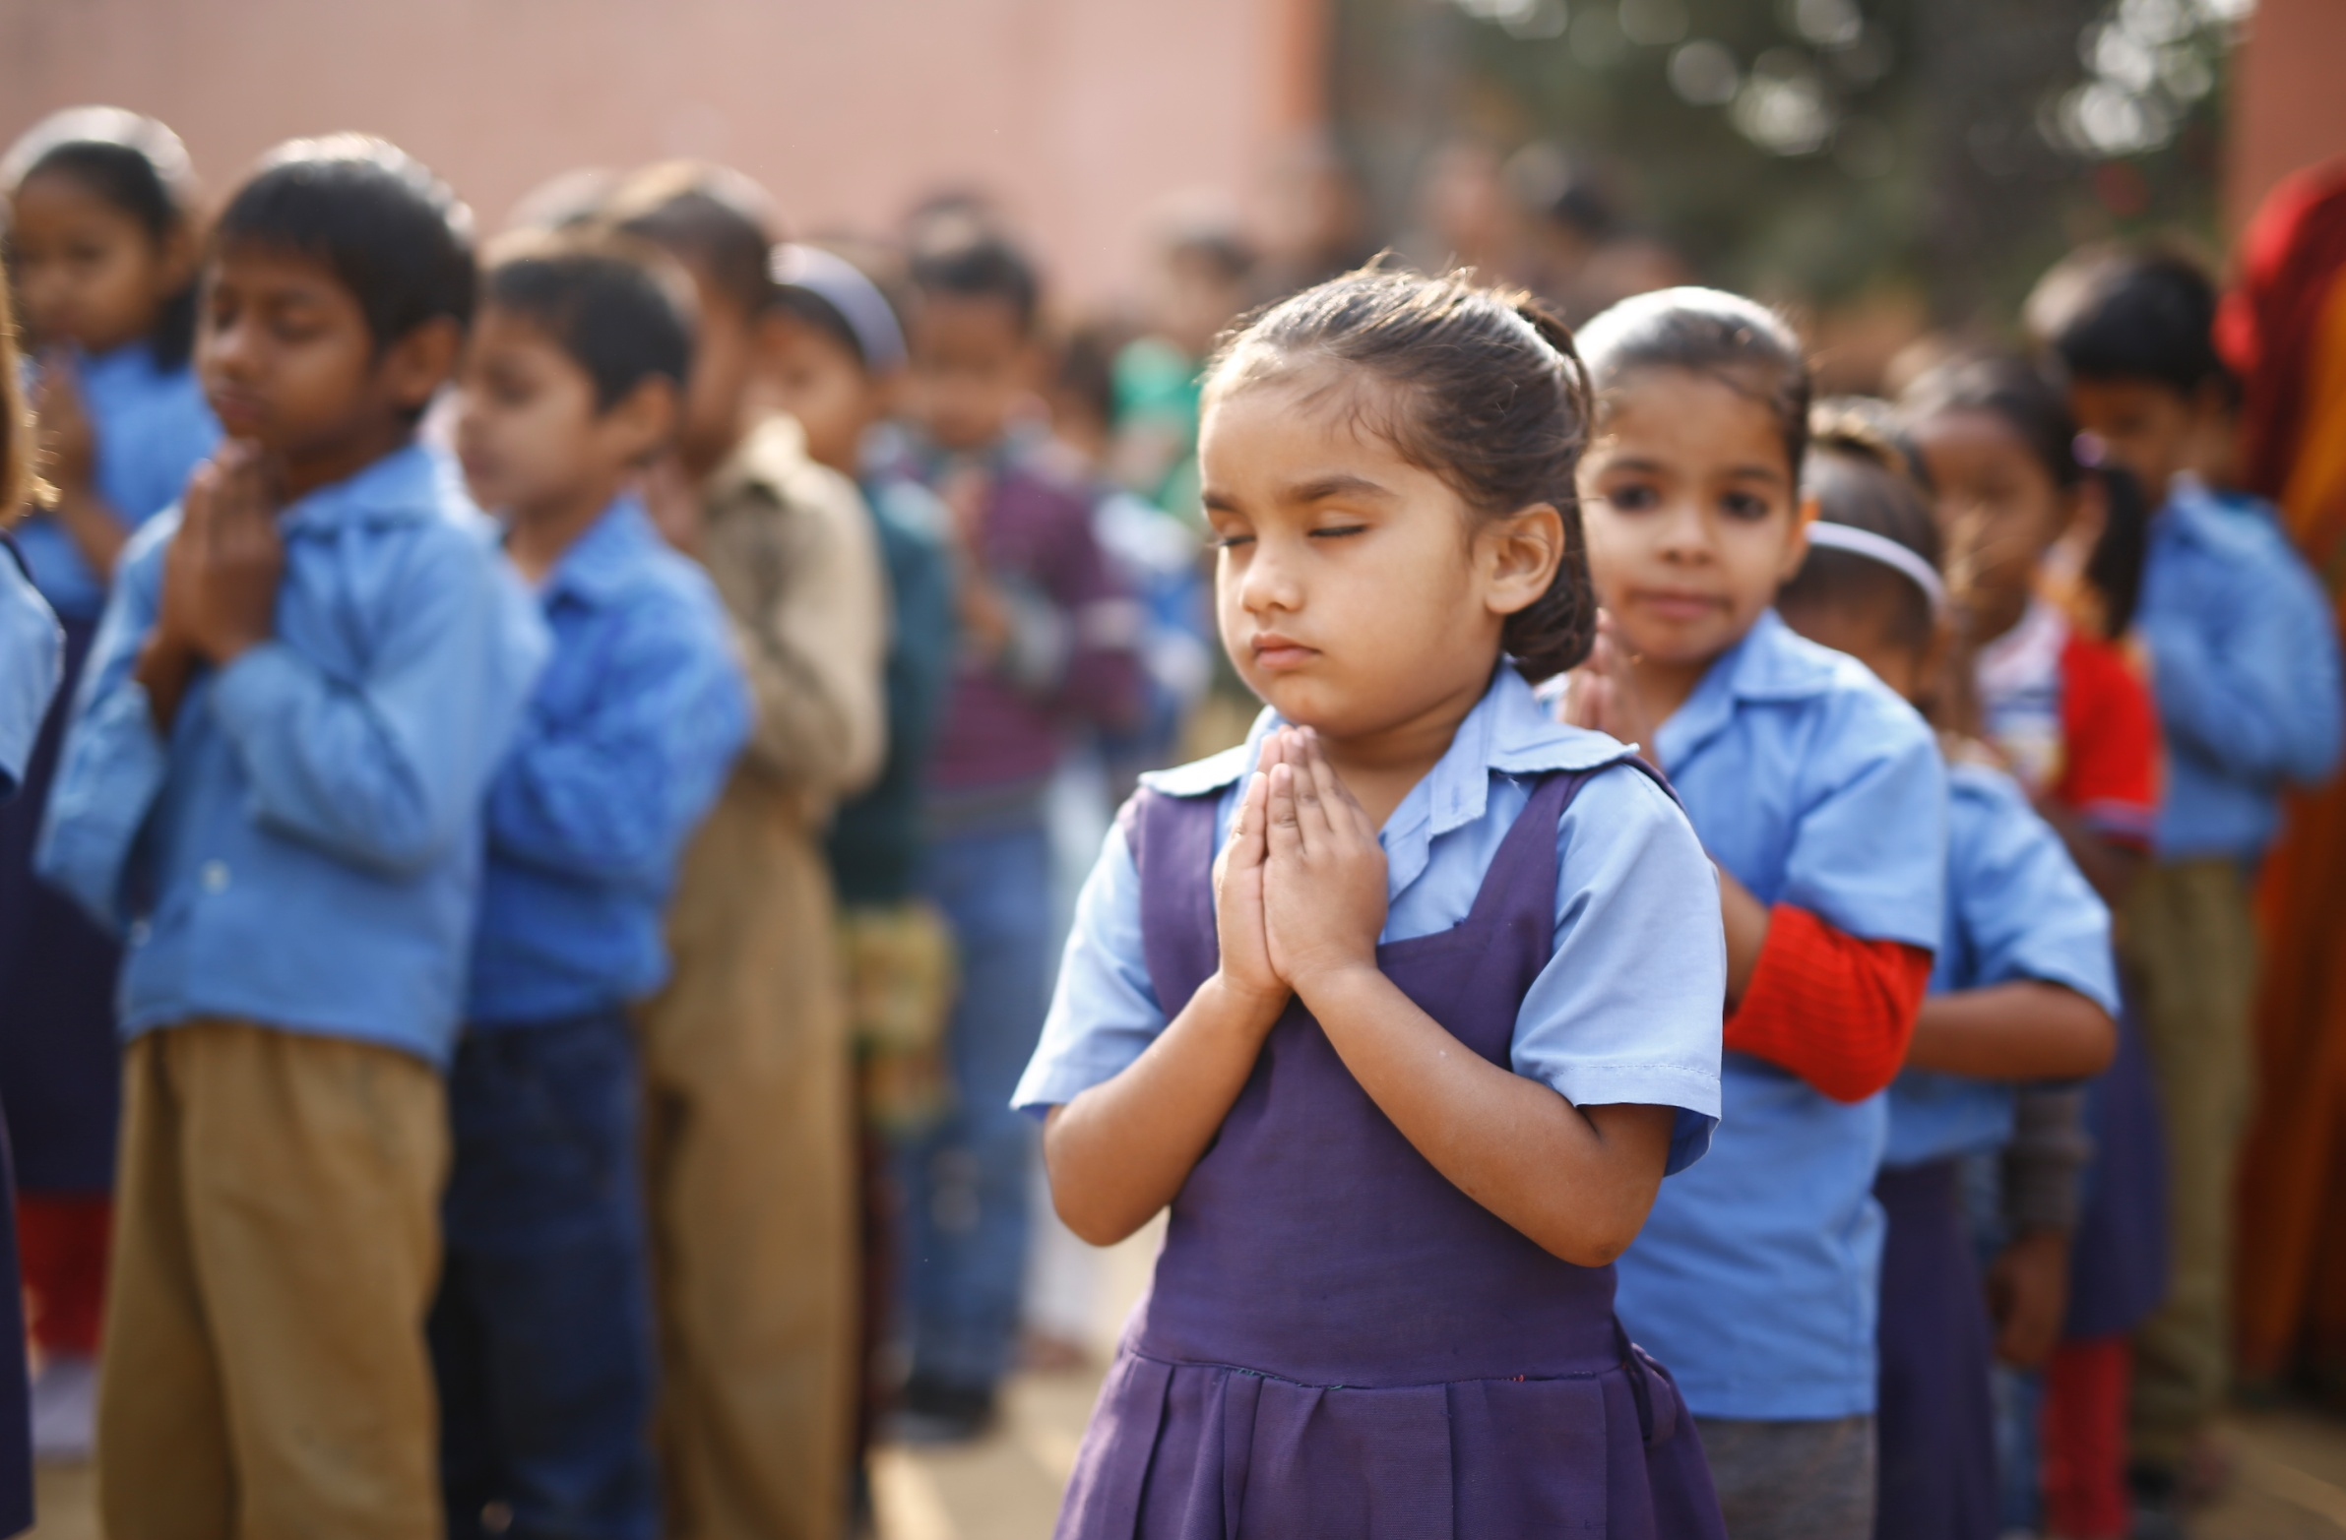
Transforming Public School Education System through Integration of Schools
22nd Dec., 2016

Slide 2
With ~18M school-age children, Rajasthan has the potential for large scale impact through their public schools
Predominantly rural desert state...
Population: ~75 M¹
Low to medium income state (USD 1,000 per capita)¹
Literacy: ~67%¹
Rajasthan
...with a sizeable school education system..
~90% gross enrolment ratio (~18M school-age children) ²
~53% students in public schools ²
~65K state government schools with ~36K private schools²
...but learning outcomes in public school poorer than national averages
Consistently in 3rd quartile of Indian states in standard national tests³
Less than 50% students at grade-level ⁴
Source : 1. 2011 census of India 2. UDISE 2015-16 3. National Achievement Survey(NAS) and Annual Status of Education Report(ASER) reports 4. GoR's SIQE baseline assessment

Slide 3
Poor Condition & Uneven availability of schools at different levels
Multiple systemic issues in the education sector two years back (2013-14)…….
Too many primary schools (2.21 per village)
Insufficient Sr. Sec. schools (0.37 per Gram panchayat)
Sub-scale school sizes (28K schools with <30 students)
Low transition rates: VIII to IX at 90% X to XI at 50%
Poor / insufficient school infrastructure
Teacher & school staff vacancies > 60%

Slide 4
Management Issues
Multiple systemic issues in the education sector two years back (2013-14)…….
Compartmentalized setup: I-V/VIII schools under Elementary/ Panchayati Raj Deptt. & VI-X/XII schools under Sec. Edu. Deptt.
Fragmented Authority caused lack of control & accountability
Students were required to change school at least 2/3 times for completion of education upto XII.
Poor coordination across programs, departments and partners.
Lack of school support, supervision and monitoring

Slide 5
Resource and process constrained department
Multiple systemic issues in the education sector two years back (2013-14)…….
Departmental vacancies (Supervisory Levels) >60%
No real time school and student level MIS system
Weak leadership and management structures at school / department level
Poor resource availability per school due to large number of schools
Sub optimal utilization of resources
Poor Quality of educational outcome.

Slide 6
Important components of strategy
1
Integration of schools
2
Strengthening of schools
3
Improving Management structures

Slide 7
1. Integrated Schools of KG to 10/12
PS/UPS/Sec. schools integrated with other PS/ UPS/ Sec./ Sr. Sec. Schools in the same village within RTE norms.
Integration of 13,900 PS/UPS with Sec./Sr. Sec. schools for establishing 13304 integrated schools (1-10/12)
Up gradation of 5000 Secondary schools to Sr. secondary level for improving access to Sr. Sec. education with the aim to have at least one class 1-12 school in each of 9895 Gram Panchayats.
Integration of Anganwadi centers with integrated school for strengthening pre primary education.
2383 PS/UPS integrated with 2151 PS/UPS located in close proximity.

Slide 8
2. Strengthening of Schools
Adarsh Vidyalaya Yojana (9895)
Total Sec / Sr. Sec Schools : 13527
Utkrisht Vidyalaya Yojana (9670)
Total UPS (Ele. Education) : 19280
Every gram panchayat in Rajasthan to have one Adarsh school of class 1-12 by March 2018 with following:
<10% teacher vacancies
Quality infrastructure
>75% students at grade
Scheme started in 2015-16
Schools being strengthened in three phases
Phase-1 (2015-16) – 1,340 schools
Phase-2 (2016-17)– 3,097 schools
Phase-3 (2017-18)– 5,458 schools
To cover 46 Lakh students by 2018
Another school of class 1-8 to be developed as Utkrisht School, under mentorship of Adarsh School, in every gram panchayat. Utkrisht School to have following:
<10% teacher vacancies
Quality infrastructure
>75% students at grade
Scheme started in 2016-17
Schools being strengthened in two phases:
Phase-1 (2016-17) – 4289 schools
Phase-2 (2017-18) – 5381 schools
To cover 15 Lakh students by 2018

Slide 9
3. Improving Management structures
Staffing norms and Rationalization:
Staffing norms based on enrolment and level of the school
Rationalization of staff done based on norms
Availability of teachers in remote areas and optimum utilization
Effective use of manpower through allocation of broader range of classes to be taught- 9-12 to PGTs , 6-10 to TGTs, 1-8 to Teachers Level 2 and 1-5 to teachers Level 1
Posting of teachers through online counseling
Real-time status of vacancies can be tracked transparently
Physically challenged, widows, divorcee and other women given preference
1 lakh teachers posted through counseling

Slide 10
3. Improving Management structures
Established on line MIS System:
Shaaladarpan (For All Sec. Edu. Deptt. Schools)
Database of 13659 schools, 44 Lakh Students & ~2.16 Lakh staff created
All school level information is entered by the school itself.
Shaaladarshan (For All Ele. Edu. Deptt. Schools)
Database of 50970 schools, 35 Lakh Students & ~1.6 Lakh staff created.
Internal Communication:
Use of technology in a better way
Video Conferences with district level functionaries, Principals & teachers using 2000 ICT centers in schools and 12 DLSRs
Whatsapp/Telegram groups with district officers and principals
Bulk e-mail/ SMS facilities

Slide 11
Impact
Reduction in no. of school mgmt. units from 85K to 65K resulting in better school supervision
Increase in enrolment in integrated schools by 10 lakh in 2 years- 2.5 lakh in class 1-5.
Better teacher availability- at least one teacher per class in integrated schools
Student transition from class VIII to IX improved from 90% in 2013-14 to 95% in 2015-16
Increase in access to senior secondary schools causing increase in class X to XI student transition rate from 50% in 2013-14 to 66% in 2015-16.
One lakh new students enrolled in class XI in 2015-16
Improved Board results
58%(2014) to 72%(2016) for class X,
78%(2014) to 86% (2016) for class XII
1st , 3rd & 4th merit in Class XII Arts Board result from Govt. School.

Slide 12
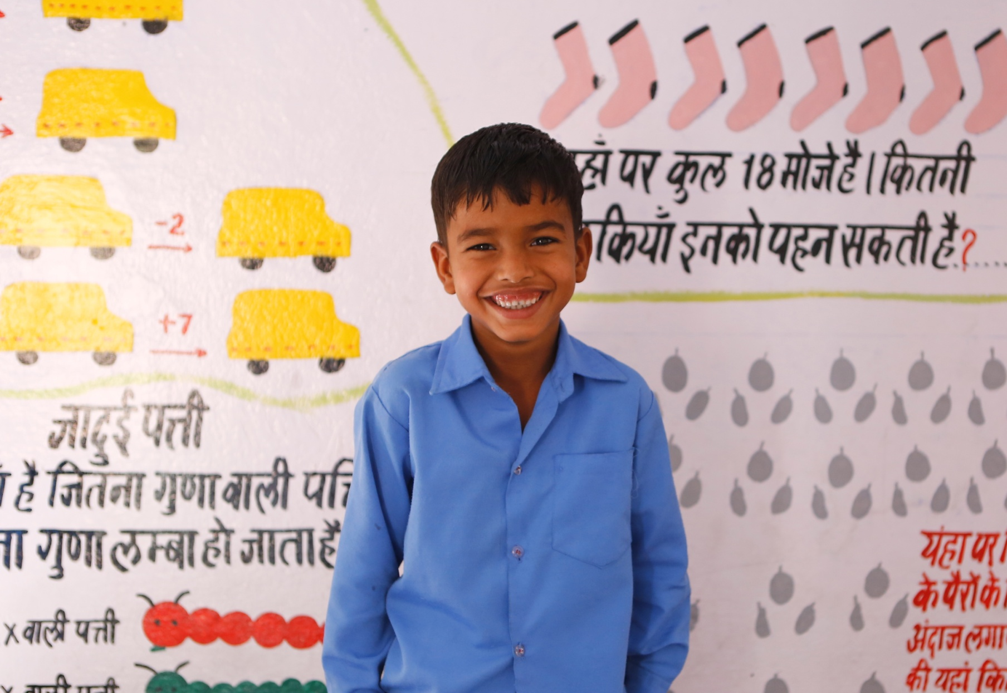
Thank you

