Slide 1
October, 2014
New Delhi – India
Mohammed A.Elah
I-Seha Program Office
Ministry of Health - Kingdom of Bahrain
United Nations Public
Service Award 2014

Slide 2
About I-Seha Program
Ministry of Health decided to implement a National Health Information System (I-Seha) with Indra Company, as a key component of the Ministry’s vision to improve healthcare services which provides a modern, intelligent and integrated informed healthcare system.
It is a paperless/filmless project, it integrates clinical and administrative solution for primary and secondary care, and patient information will be compiled in a single Electronic Health Record; available where and when needed.

Slide 3
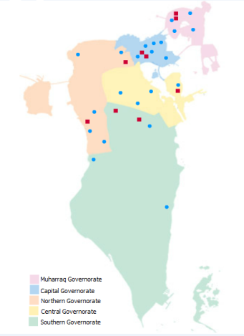
The National Health Information System
King Hamad University Hospital
Salmaniya Medical
Complex
Peripheral Hospitals
26 Health Centres
3

Slide 4
Why I-Seha Program?
There were a need for:
Quick transfer of health data between professionals
Unlimited access to health records between hospitals
Integration of all medial and paramedical services given to patients
Availability of data for informed decisions
Delivering latest evidence based medicine through technology.
Improving the quality of care
Safely secured information

Slide 5
Program Scope
APPLICATION SCOPE
PATIENT MEDICAL DATA AND RESOURCES UTILIZATION
TECHNICAL SCOPE
USERS WORKPLACE – SERVERS – NETWORK
OPERATION & SERVICE SCOPE
HELP DESK, MAINTENANCE AND UPGRADE FOR 11 YEARS
PROGRAM IMPLEMENTATION SCOPE
CUSTOMIZATION AND IMPLEMENTATION

Slide 6
Best Practice
Service Project based on an Outsourcing model
National Electronic Health Record
Ready to be integrated with the Private Sector
Build, Own, Operate and Transfer
e-Health following the e-Government initiative

Slide 7
Alignment with 2030 Vision
The Bahrain Economic Vision 2030 stipulates the universal availability of quality healthcare and by 2030, positions Bahrain as a leading centre of modern medicine in the region.
The MoH have worked hard on taking this decision to make a strategic plan (Bahrain’s Health Agenda 2011-2014) and choosing I-SEHA one of its key strategies to do that.
I-SEHA -and all its modules- was clearly stated as a need in the strategic plan.

Slide 8
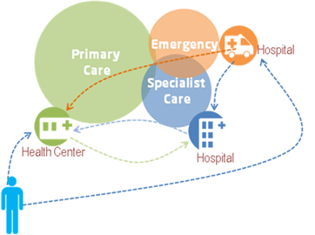
Integrated Program

Slide 9
Sustainable Program
There are three factors that can warrantee the sustainability of I-Seha:
1) The commitment of the MoH and main stakeholders: This initiative is part of I-SEHA which is one of the major projects carried out recently to modernize Bahrain’s health system.
2) The benefits for professionals and end users: This project facilitates the work of healthcare givers and therefore, they are the most interested in sustain this system.
3) The return on investment: by enhancing productivity, saving money and improving people’s health.

Slide 10
Components to Succeed
Definition and implementation of processes following the Best Practices and the specific requirements of a Healthcare environment
Implementation of full-proof solution, with a robust architecture, scalable and with high availability
Processes
Technology
People
Change Management, Training and Local Support are critical tasks and must be managed as projects in itself.

